Slide 1

Unit-1 C# (C-Sharp) Fundamentals
Web Programming using .NET
#2305CS311
Prof. Madhuresh R Fichadiya
Computer Science & Engineering Department
madhuresh.fichadiya@darshan.ac.in
8866961282

Slide 2

.NET Core v/s .NET Framework
.NET Core
.NET core and released new framework in 2016
.NET Core is highly useful for building web apps, ASP.NET Core apps, mobile apps and Universal Windows Platform apps.
.NET core is for creating cross-platform cloud apps that run on Windows, Mac, and Linux
It allows you to seamlessly enhance app performance without any hardware.
It supports microservices by creating REST API.
.NET Framework
.NET framework released in 2002
.NET framework helps you build web apps, desktop apps, and web services.
It works only on the Windows operating system.
The .NET Framework trails behind in performance.
It does not come up with much flexibility, security, and speed.
It does not support microservices.

Slide 3

Outline
Introduction to C#
Namespace
Console Class Methods
Data Types & Variables
Operators
Arrays
Strings
Classes/Objects
Constructors
Inheritance
Abstraction
Interface
Exception Handling
Properties
Collection Classes
Looping

Slide 4
C#: Introduction
Section - 1

Slide 5
C#: Introduction
C# is a general-purpose, modern and object-oriented programming language pronounced as “C sharp”.
C# has roots from the C family, and the language is close to other popular languages like C++ and Java.
The first version was released in year 2002. The latest version, C# 14.0 was released in June 2024.
C# is case-sensitive; "MyClass" and "myclass" have different meaning.
It was developed by Microsoft led by Anders Hejlsberg and his team.
C# is used for:
Mobile, Desktop, Web Applications
Web Services
Web Sites
Games
VR, Database Applications
And, much more!

Slide 6
C#: Features
Object Oriented Language
C# is an object-oriented language.
This means that development is easier if there are long codes in large projects as compared to procedure-oriented programming languages.
Structured programming language
The programs in C# can be structured by breaking them into smaller parts using functions.
This makes the program easier to understand.
Simple to use
It is quite simple to use C# as it has various features and functionalities.
Moreover, it provides a structured approach that makes the program easier to understand.
Scalable language
C# is an automatically scalable as well as updatable language.
The old files are regularly updated and replaced with new ones.

Slide 7
C#: Hello World!
First Program

Slide 8
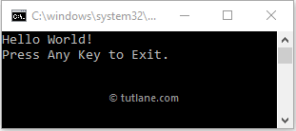
Hello World! In C#
Program.cs
Output
1
2
3
4
5
6
7
8
9
10
11
12
13
14
15
using System;
namespace HelloWorld
{
class Program
{
static void Main(string[] args)
{
// This is a comment.
Console.WriteLine("Hello World!");
Console.WriteLine("Press Enter Key to Exit.");
Console.ReadLine();
}
}
}

Slide 9
Explanation: C# Hello World Program
using System;
Here, using System is the .NET Framework library namespaces, and we used using keyword to import system namespace to use existing class methods such as WriteLine(), ReadLine(), etc. By default, the .NET Framework provides a lot of namespaces to make the application implementation easy.
namespace HelloWorld
Here, namespace HelloWorld is the main namespace of our application, and by default, our application classes will be a part of it.
class Program
Here, class Program is used to define a class (Program) in the namespace (Helloworld). The class (Program) will contain all the variables, methods, etc., and we can define more than one class in same namespace based on our requirements.
static void Main(string[] args)
The keyword static tells us that the main method can be accessible without instantiating the class (Program). Another keyword void tells us that what this method should return. The name Main will refer to the name of our class method (Program). The Main() method is the entry point of our application. Here, Console.WriteLine() and Console.ReadLine() methods are used to write a text to the console and read the input from the console.

Slide 10
Namespace
Section - 2

Slide 11
Namespaces
Namespaces are used in C# to keep one set of names separated from another.
This is done to organize the classes so, that they are easy to handle.
If there are two classes with the same names in different namespaces, they do not conflict with one another.
The .NET Framework uses namespaces to organize its built-in classes also.
We can say it is a container for classes and namespaces (Nested namespaces also allowed).
There are some built-in namespaces in .NET such as System, System.Linq, System.Web, etc. Each namespace contains specific related set of classes.
Namespaces are not mandatory in a C# program, but they do play an important role in writing cleaner codes and managing larger projects.
Example: Namespace
1
2
3
4
namespace namespace_name
{
// define classes here
}

Slide 12
Namespaces Cont..
The following namespace contains the Student and Course classes.
Example: Namespace
1
2
3
4
5
6
7
8
9
10
11
12
namespace School
{
class Student
{
}
class Course
{
}
}

Slide 13
Namespaces Cont..
The following namespace contains the Student and Course classes.
Classes under the same namespace can be referred to as namespace.classname syntax.
For example, the Student class can be accessed as School.Student.
Example: Namespace
Example: Namespace
1
2
3
4
5
6
7
8
9
10
11
12
namespace School
{
class Student
{
}
class Course
{
}
}
1
2
3
4
5
6
7
8
9
10
11
namespace DUDemo
{
class Program
{
static void Main(string[] args)
{
School.Student std = new School.Student();
School.Course cs = new School.Course();
}
}
}

Slide 14
Namespaces Cont..
To use classes under a namespace without the fully qualified name, import the namespace with the using keyword at the top of C# class file.
Example: Namespace
Example: Namespace
1
2
3
4
5
6
7
8
9
10
11
12
13
using System; //built-in namespace
using School;
namespace DUDemo
{
class Program
{
static void Main(string[] args)
{
Student std = new Student();
}
}
}
1
2
3
4
5
6
7
8
9
10
11
12
namespace School
{
class Student
{
}
class Course
{
}
}

Slide 15
Nested Namespace
A namespace can contain another namespace, It is called nested namespace.
The nested namespace and its members can also be accessed using the dot (.) operator.
Example: Nested Namespace
1
2
3
4
5
6
7
namespace namespace_name
{
namespace namespace_name
{
// code
}
}

Slide 16
Console Class Methods
Section - 3

Slide 17
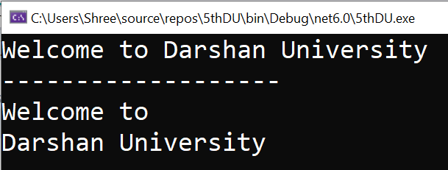
Console.WriteLine() & Console.Write()
The Console.WriteLine() and Console.Write() methods print values or texts to the console.
Console.WriteLine() method prints a new line after the text or a value.
Console.Write() method only prints the text or value without a new line.
Example
Output
1
2
3
4
5
6
7
8
9
10
11
12
13
14
15
16
using System;
namespace MyFirstApp
{
class Program
{
public static void Main(string[] args)
{
Console.Write("Welcome to");
Console.Write(" Darshan University");
Console.WriteLine("\n-------------------");
Console.WriteLine("Welcome to ");
Console.WriteLine("Darshan University");
Console.ReadLine();
}
}
}

Slide 18
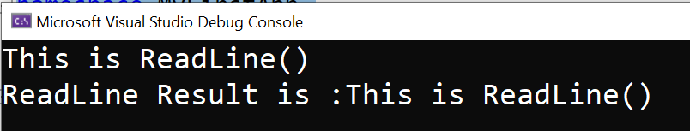
Console.ReadLine()
Console.ReadLine()
Reads the next line of characters from the standard input stream.
Simply you can say, it read all the characters from user input. (and finish when press enter).
It returns a STRING so data type should be STRING.
It means it reads all characters until the end of line.
Example
Output
1
2
3
4
5
6
7
8
9
10
11
12
using System;
namespace MyFirstApp
{
class Program
{
public static void Main(string[] args)
{
string name = Console.ReadLine();
Console.WriteLine("ReadLine Result is :"+name);
}
}
}

Slide 19

Console.Read()
Console.Read()
Reads the next character from the standard input stream.
It only accept single character from user input and return its ASCII Code.
Data type should be int, because it returns an integer value as ASCII.
E.g. As we input "6" and it return its ASCII value "54".
Example
Output
1
2
3
4
5
6
7
8
9
10
11
12
using System;
namespace MyFirstApp
{
class Program
{
public static void Main(string[] args)
{
int val = Console.Read();
Console.WriteLine("Read Result is :"+val);
}
}
}

Slide 20
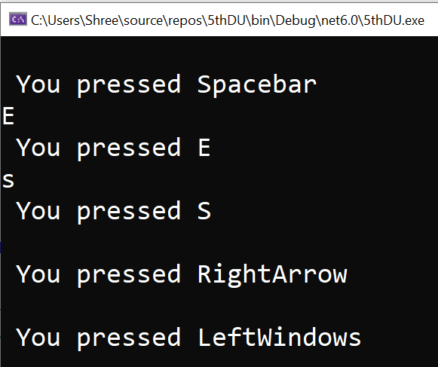
Console.ReadKey()
Console.ReadKey()
It obtains the next character or function key pressed by the user.
In simple words, it read that which key is pressed by user and return its name.
It does not require to press enter key before entering.
It is STRUCT Data type which is ConsoleKeyInfo.
Example
Output
1
2
3
4
5
6
7
8
9
10
11
12
13
14
using System;
namespace MyFirstApp
{
class Program
{
public static void Main(string[] args)
{
while (true)
{
ConsoleKeyInfo key = Console.ReadKey();
Console.WriteLine("\n You pressed " + key.Key);
}
}
}
}

Slide 21
Data Types & Variables
Section - 4

Slide 22
Data Types & Variables
Variables are containers for storing data values.
In C#, there are different types of variables (defined with different keywords), for example:
int - stores integers (whole numbers), without decimals, such as 123 or -123
double - stores floating point numbers, with decimals, such as 19.99 or -19.99
char - stores single characters, such as 'a' or 'B'. Char values are surrounded by single quotes
string - stores text, such as "Hello World". String values are surrounded by double quotes
bool - stores values with two states: true or false
Declaring (Creating) Variables
1
type variableName = value;
Example: Variables
1
2
3
4
5
int Num = 15;
double Number = 15.50;
char values = ‘B’;
string name = “Darshan University”;
bool isClosed = false;

Slide 23
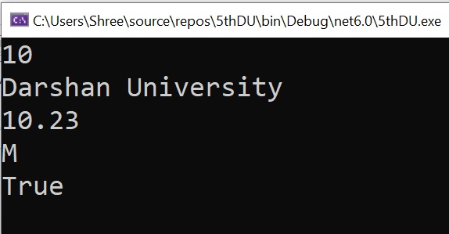
Example: Data Types & Variables
Program.cs
Output
1
2
3
4
5
6
7
8
9
10
11
12
13
14
15
16
17
18
19
20
21
22
23
using System;
namespace MyFirstApp
{
class Program
{
static void Main(string[] args)
{
int number = 10;
string name = "Darshan University";
double percentage = 10.23;
char gender = 'M';
bool isVerified = true;
Console.WriteLine(number);
Console.WriteLine(name);
Console.WriteLine(percentage);
Console.WriteLine(gender);
Console.WriteLine(isVerified);
Console.ReadLine();
}
}
}

Slide 24

Rules to Declaring a Variable in C#
Before we declare and define variables in the c# programming language, we need to follow particular rules.
You can define a variable name with a combination of alphabets, numbers, and underscore.
A variable name must always start with either alphabet or underscore but not with numbers.
While defining the variable, no white space is allowed within the variable name.
Don't use any reserved keywords such as int, float, char, etc., for a variable name.
In c#, once the variable is declared with a particular data type, it cannot be re-declared with a new type, and we shouldn’t assign a value that is not compatible with the declared type.
Valid
Invalid
1
2
3
4
5
int abc; float a2b; char _abc;
int a,b,c;
float x, y, z = 10.5;
1
2
3
4
int a b c; float 2abc; char &abc; double int;

Slide 25
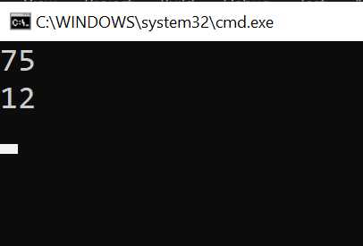

Guess the Output??
Program.cs
Output
1
2
3
4
5
6
7
8
9
10
11
12
13
14
15
16
17
18
using System;
namespace Variables
{
class Program
{
static void Main(string[] args)
{
int x = 7;
string y = "5";
string myFirstTry = x.ToString() + y;
int mySecondTry = x + int.Parse(y);
Console.WriteLine(myFirstTry);
Console.WriteLine(mySecondTry);
Console.ReadLine();
}
}
}

Slide 26
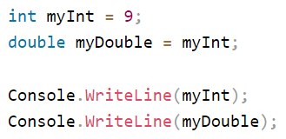
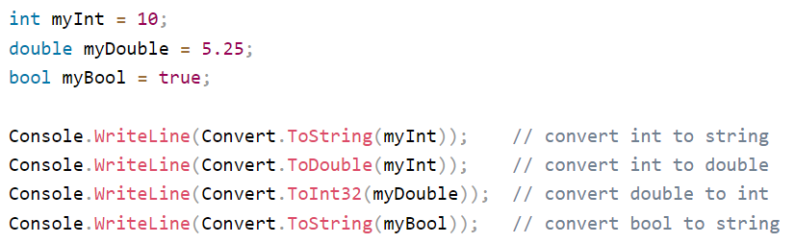
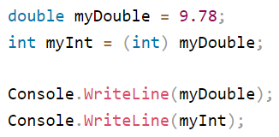
Guess the Output??
Implicit Casting
Type Conversion Methods
Explicit Casting

Slide 27
Operators
Section - 5

Slide 28
Operators
Operators in C# are some special symbols that perform some action on operands.
In mathematics, the plus symbol (+) do the sum of the left and right numbers. In the same way, C# includes various operators for different types of operations.
The following example demonstrates the + operator in C#.
In the above example, + operator adds two number literals and assign the result to a variable.
It also adds the values of two int variables and assigns the result to a variable.
Some operators behave differently based on the type of the operands.
For example, + operator also concatenates two strings.
Example
1
2
3
int x = 5 + 5;
int y = 10 + x;
int z = x + y;

Slide 29
Type of Operators
Arithmetic Operators
Relational Operators
Logical Operators
Assignment Operators

Slide 30
Arithmetic Operators
A =10, B=20
Operator | Description | Example
+ | Adds two operands | A + B = 30
- | Subtracts second operand from the first | A - B = -10
* | Multiplies both operands | A * B = 200
/ | Divides numerator by de-numerator | B / A = 2
% | Modulus Operator and remainder of after an integer division | B % A = 0
++ | Increment operator increases integer value by one | A++ = 11
-- | Decrement operator decreases integer value by one | A-- = 9

Slide 31
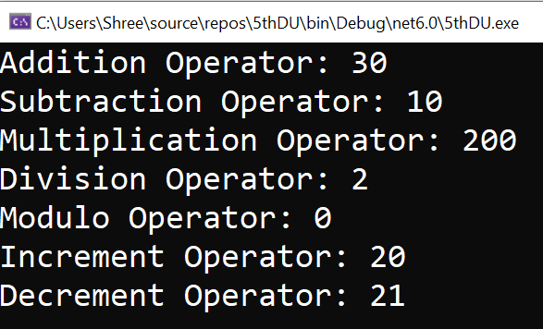
Example: Arithmetic Operators
Example
Output
1
2
3
4
5
6
7
8
9
10
11
12
13
14
15
16
17
18
19
20
21
22
23
24
25
26
27
using System;
namespace MyFirstApp
{
class Program
{
public static void Main(string[] args)
{
int ans;
int x = 20, y = 10;
ans = (x + y);
Console.WriteLine("Addition Operator: " + ans);
ans = (x - y);
Console.WriteLine("Subtraction Operator: " + ans);
ans = (x * y);
Console.WriteLine("Multiplication Operator: " + ans);
ans = (x / y);
Console.WriteLine("Division Operator: " + ans);
ans = (x % y);
Console.WriteLine("Modulo Operator: " + ans);
ans = (x++);
Console.WriteLine("Increment Operator: " + ans);
ans = (x--);
Console.WriteLine("Decrement Operator: " + ans);
Console.ReadLine();
}
}
}

Slide 32
Relational Operators
A =10, B=20
Operator | Description | Example
== | Checks if the values of two operands are equal or not, if yes then condition becomes true. | (A == B) is not true.
!= | Checks if the values of two operands are equal or not, if values are not equal then condition becomes true. | (A != B) is true.
> | Checks if the value of left operand is greater than the value of right operand, if yes then condition becomes true. | (A > B) is not true.
< | Checks if the value of left operand is less than the value of right operand, if yes then condition becomes true. | (A < B) is true.
>= | Checks if the value of left operand is greater than or equal to the value of right operand, if yes then condition becomes true. | (A >= B) is not true.
<= | Checks if the value of left operand is less than or equal to the value of right operand, if yes then condition becomes true. | (A <= B) is true.

Slide 33
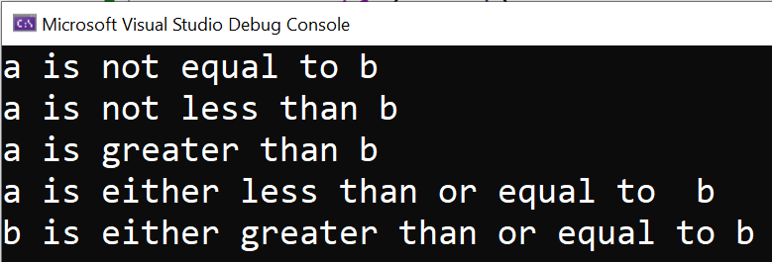
Example: Relational Operators
Example
Output
1
2
3
4
5
6
7
8
9
10
11
12
13
14
15
16
17
18
19
20
21
22
23
24
25
26
27
28
29
using System;
namespace MyFirstApp
{
class Program
{
public static void Main(string[] args)
{
int a = 21, b = 10;
if (a == b)
Console.WriteLine("a is equal to b");
else
Console.WriteLine("a is not equal to b");
if (a < b)
Console.WriteLine("a is less than b");
else
Console.WriteLine("a is not less than b");
if (a > b)
Console.WriteLine("a is greater than b");
else
Console.WriteLine("a is not greater than b");
/* Lets change value of a and b */
a = 5; b = 20;
if (a <= b)
Console.WriteLine("a is either less than or equal to b");
if (b >= a)
Console.WriteLine("b is either greater than or equal to b");
}
}
}

Slide 34
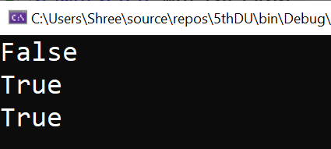
Logical Operators
Operator | Description | Example (x=5)
&& | Logical AND | Returns True if both statements are true | x < 5 && x < 10 (False)
|| | Logical OR | Returns True if one of the statements is true | x > 3 || x < 4 (True)
! | Logical NOT | Reverse the result, returns False if the result is true | !(x > 3 && x < 10) (False)
Example
Output
1
2
3
4
5
6
7
8
9
10
11
12
13
14
15
16
using System;
namespace MyFirstApp
{
class Program
{
public static void Main(string[] args)
{
bool a = true;
bool b = false;
Console.WriteLine(a && b);
Console.WriteLine(a || b);
Console.WriteLine(!(a && b));
Console.ReadLine();
}
}
}

Slide 35
Assignment Operators
Operator | Description | Example
= | Simple assignment operator, Assigns values from right side operands to left side operand | C = A + B assigns value of A + B into C
+= | Add AND assignment operator, It adds right operand to the left operand and assign the result to left operand | C += A is equivalent to C = C + A
-= | Subtract AND assignment operator, It subtracts right operand from the left operand and assign the result to left operand | C -= A is equivalent to C = C - A
*= | Multiply AND assignment operator, It multiplies right operand with the left operand and assign the result to left operand | C *= A is equivalent to C = C * A
/= | Divide AND assignment operator, It divides left operand with the right operand and assign the result to left operand | C /= A is equivalent to C = C / A

Slide 36
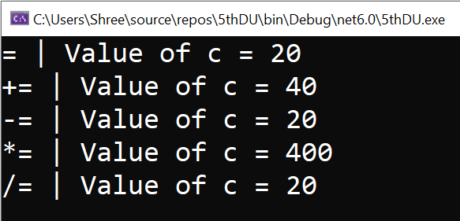
Example: Assignment Operators
Example
Output
1
2
3
4
5
6
7
8
9
10
11
12
13
14
15
16
17
18
19
20
21
22
23
using System;
namespace MyFirstApp
{
class Program
{
public static void Main(string[] args)
{
int a = 20;
int ans;
ans = a;
Console.WriteLine("= | Value of c = {0}", ans);
ans += a;
Console.WriteLine("+= | Value of c = {0}", ans);
ans -= a;
Console.WriteLine("-= | Value of c = {0}", ans);
ans *= a;
Console.WriteLine("*= | Value of c = {0}", ans);
ans /= a;
Console.WriteLine("/= | Value of c = {0}", ans);
Console.ReadLine();
}
}
}

Slide 37
Arrays
Section - 6

Slide 38
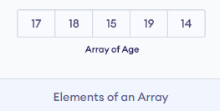
Arrays
An array is a collection of similar types of data
It is a group of like-typed variables that are referred to by a common name.
Suppose we need to record the age of 5 students. Instead of creating 5 separate variables, we can simply create an array:
In C#, here is how we can declare an array.
Array Declaration
1
Datatype[] arrayName;

Slide 39
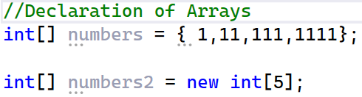
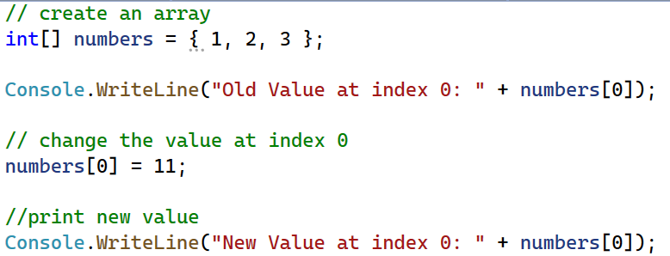
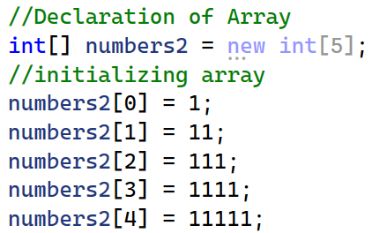
Example - Array

Slide 40
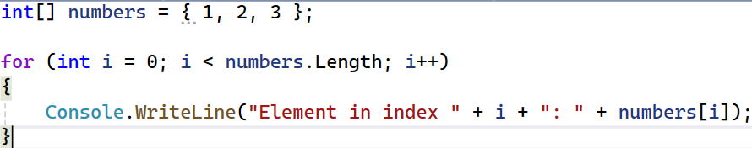
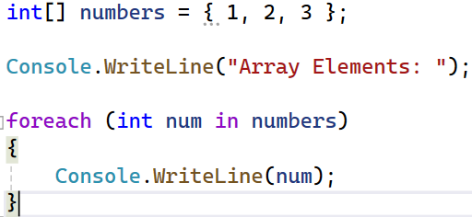
Iterating C# Array using Loops

Slide 41
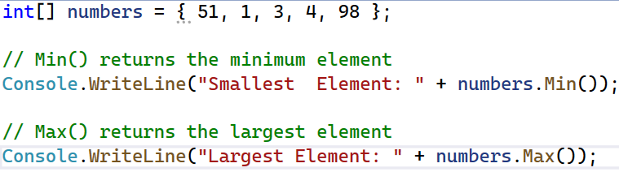
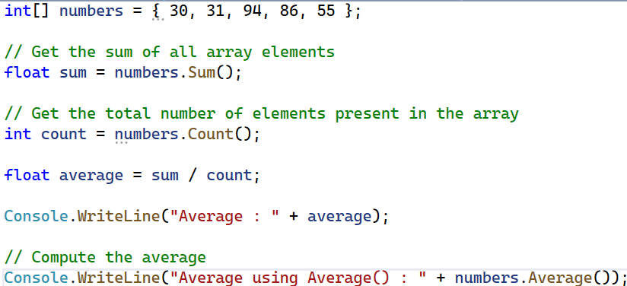
Examples - Arrays
Find Minimum and Maximum Element (using System.Linq)
Find the Average of an Array (using System.Linq)

Slide 42
Strings
Section - 7

Slide 43
String Class
A string variable contains a collection of characters surrounded by double quotes.
We can use strings as array of characters.
The string keyword is an alias for the System.String class.
Question: string is a keyword or an object or a class??
A string is represented by class System.String.
The “string” keyword is an alias for System.String class and instead of writing System.String one can use String which is a shorthand for System.String class.
So we can say string and String both can be used as an alias of System.String class.
string is an object of System.String class.
String Declaration
1
2
string Name = "Darshan";
String UName = "University";

Slide 44
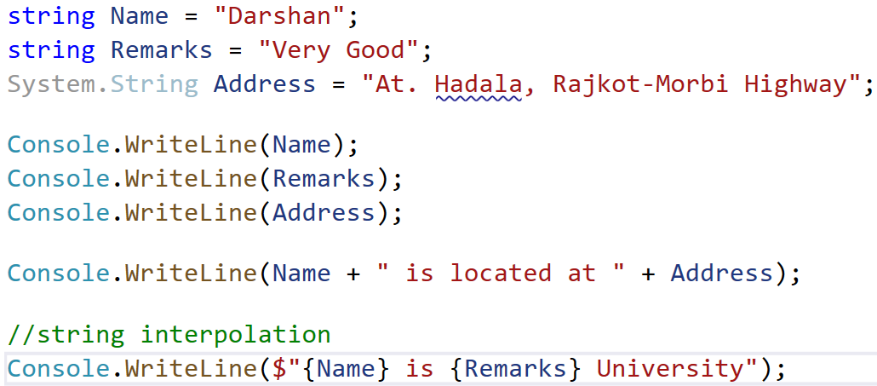
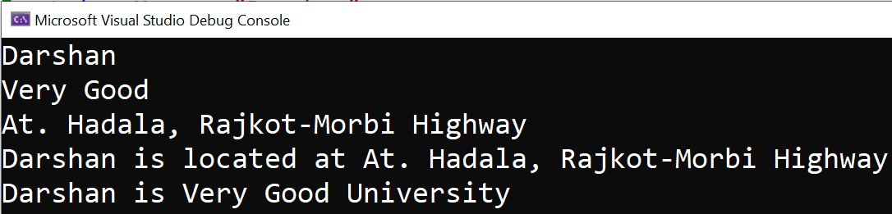
Example: String
Output

Slide 45
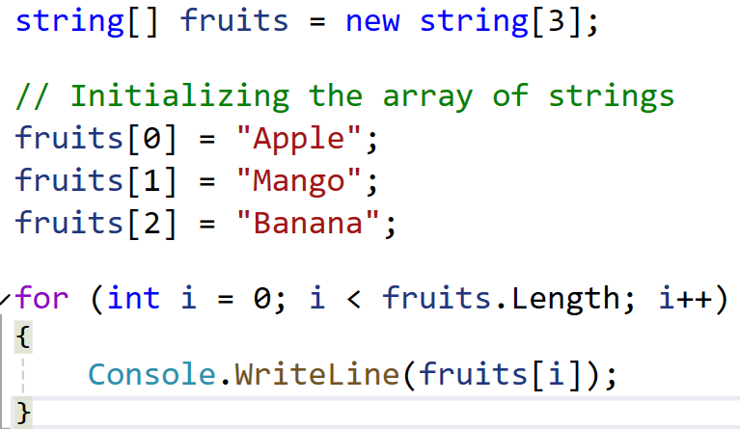
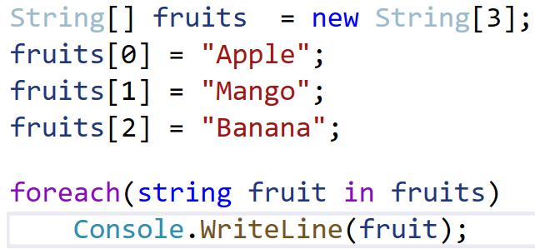
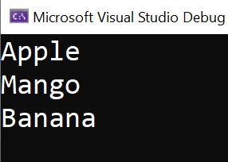
Example: String Array
Output

Slide 46
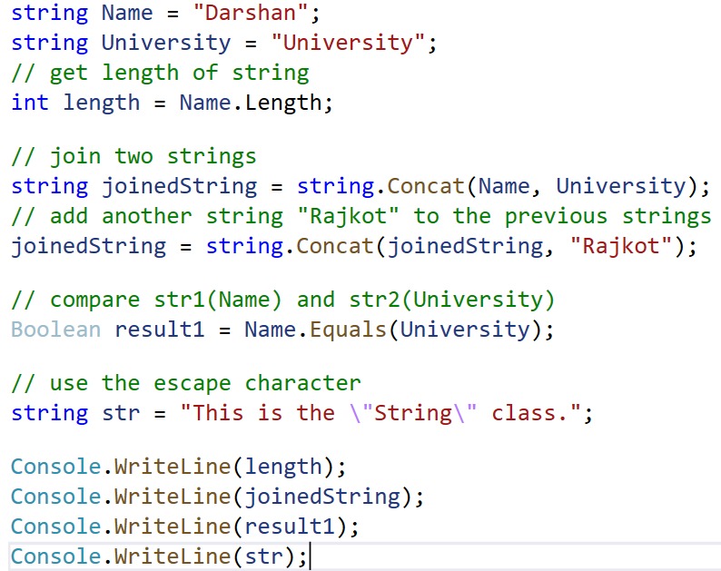
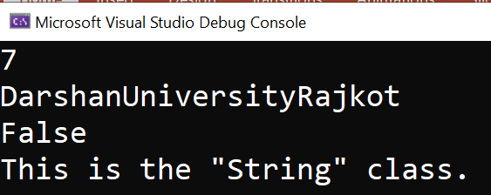
String Class Methods & Properties
Output

Slide 47
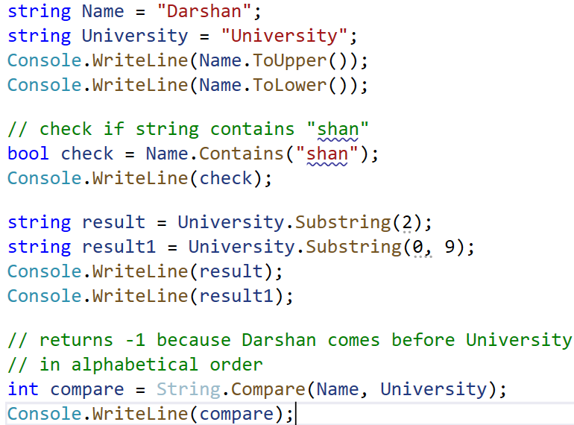
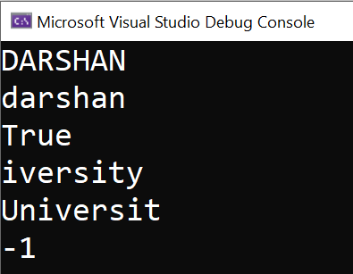
String Class Methods & Properties Cont..
Output

Slide 48
String Methods [Lab Work]
string firstname = "Steven Clark"; string lastname = "Clark";
Functions | Description
ToLower() | //Covert string into lower case Console.WriteLine(str1.ToLower());
ToUpper() | //Convert string into Upper case Console.WriteLine(str1.ToUpper());
Insert() | //Insert substring into string Console.WriteLine(str1.Insert(0, "Hello"));
LastIndexOf() | //Returns the last index position of specified value Console.WriteLine(str1.LastIndexOf("e"));
Length | //Returns the Length of String Console.WriteLine(str1.Length);
Remove() | //Deletes all the characters from begining to specified index. Console.WriteLine(str1.Remove(5));
Replace() | // Replace the character Console.WriteLine(str1.Replace('e', 'i'));

Slide 49
String Methods [Lab Work]
string firstname = "Steven Clark"; string lastname = "Clark";
Functions | Description
Clone() | // Make String Clone Console.WriteLine(str1.Clone());
CompareTo() | //Compare two string value and returns 0 for true and 1 for false Console.WriteLine(str1.CompareTo(lastname));
Contains() | //Check whether specified value exists or not in string Console.WriteLine(str1.Contains("ven"));
EndsWith() | //Check whether specified value is the last character of string Console.WriteLine(str1.EndsWith("n"));
Equals() | //Compare two string and returns true and false Console.WriteLine(str1.Equals(lastname));
IndexOf() | //Returns the first index position of specified value the first index position of specified value Console.WriteLine(str1.IndexOf("e"));

Slide 50
String Methods [Lab Work]
string firstname = "Steven Clark"; string lastname = "Clark";
Functions | Description
StartsWith() | //Check wheater first character of string is same as specified value Console.WriteLine(str1.StartsWith("S"));
Substring() | //Returns substring Console.WriteLine(str1.Substring(2, 5));
Trim() | //It removes starting and ending white spaces from string. Console.WriteLine(str1.Trim());

Slide 51
Class & Objects
Section - 8

Slide 52
Class
Class is a data structure, and it will combine various types of data members such as fields, properties, member functions, and events into a single unit.
The class is like a blueprint of a specific object that has certain attributes and features.
In c# class is nothing but a collection of various data members (fields, properties, etc.) and member functions.
For example,
A car should have some attributes such as four wheels, two or more doors, steering, a windshield, etc.
It should also have some functionalities like start, stop, run, move, etc.
Now, any object that has these attributes and functionalities is a car.
It defines the kinds of data and the functionality their objects will have.

Slide 53
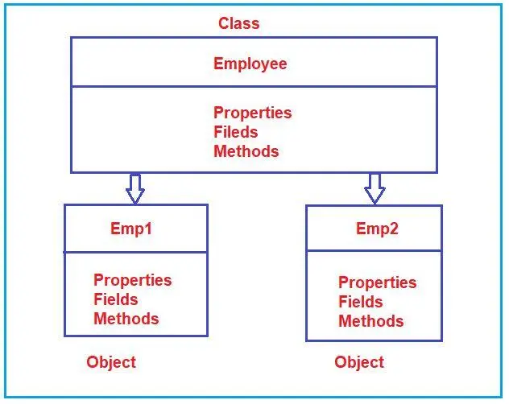
Declaring a Class in C#
We defined a class “users” using class keyword with public access modifier.
Here, the public access specifier will allow the users to create objects for this class, and inside of the body class, we can create required fields, properties, methods, and events for specific usage.
Class Declaration
1
2
3
4
Public or internal class users
{
// Properties, Methods, Events, etc.
}

Slide 54
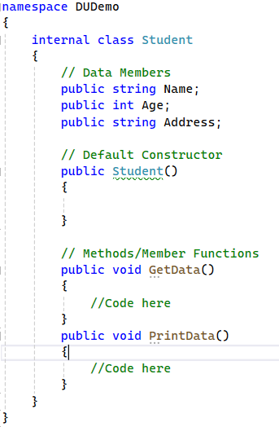
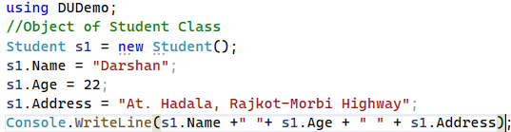

Example: Class & Object
Output

Slide 55
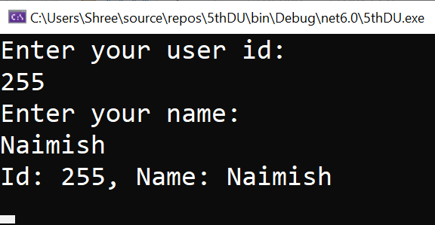
Example: Class & Object
Example
Output
1
2
3
4
5
6
7
8
9
10
11
12
13
14
15
16
17
18
19
20
21
22
23
24
25
26
27
28
using System;
namespace MyFirstApp
{
public class Users
{
public int id = 0;
public string name = string.Empty;
public void GetUserDetails()
{
Console.WriteLine("Enter your user id:");
id = Convert.ToInt32(Console.ReadLine());
Console.WriteLine("Enter your name:");
name = Console.ReadLine();
Console.WriteLine("Id: {0}, Name: {1}", id, name);
Console.ReadLine();
}
}
class Program
{
public static void Main(string[] args)
{
Users user = new Users();
user.GetUserDetails();
}
}
}

Slide 56
Objects of a Class
Objects are real-world entities and also called as instance of a class.
For example, chair, car, pen, mobile, laptop etc.
We can create one or more objects of a class.
Each object can have different values of properties and field but, methods and events behaves the same.
Object Creation
Create Multiple Objects
1
Student student1 = new Student();
1
2
3
4
5
6
7
Student student1 = new Student();
student1.FirstName = "Raj";
student1.LastName = "Mehta";
Student student2 = new Student();
student2.FirstName = "Abhay";
student2.LastName = "Doshi";
Access Members of a Class
1
2
3
4
5
6
Student student1 = new Student();
student1.FirstName = "Naimish";
student1.LastName = "Patel";
student1.GetFullName();

Slide 57
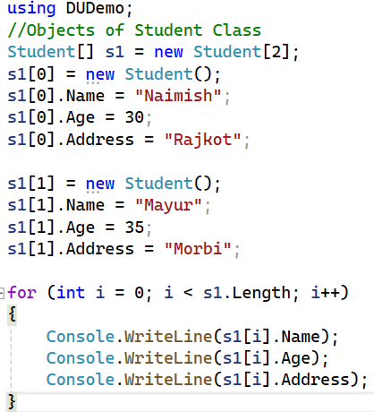

Example: Class & Object (for loop)
Output

Slide 58
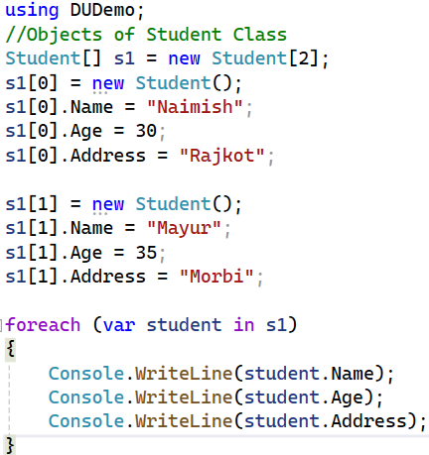
Example: Class & Object (foreach loop)
Output

Slide 59
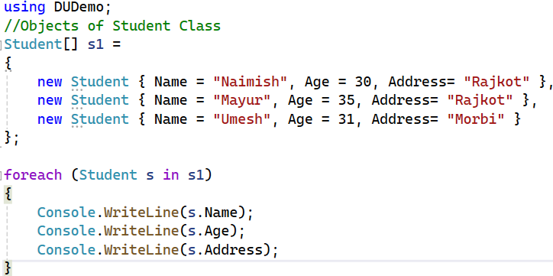
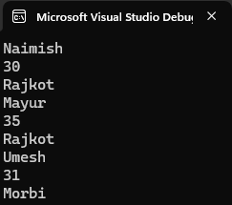
Example: Class & Object (foreach loop)
Output

Slide 60
Constructor
Section - 9

Slide 61
Constructor
A constructor is a special type of method which will be called automatically when you create an instance of a class.
A constructor is defined by using an access modifier and class name
<access-modifier> <class-name>(){ }.
Example
Constructor Characteristics
1
2
3
4
5
6
7
public class Student
{
public Student()
{
//constructor
}
}
A constructor name must be the same as a class name.
A constructor can be public, private, or protected.
The constructor cannot return any value so, cannot have a return type.
A class can have multiple constructors with different parameters but can only have one parameter less constructor.
If no constructor is defined, the C# compiler would create it internally.

Slide 62
Type of Constructor
Constructors can be classified as follows.
Default Constructor
By default, C# creates default constructor internally.
Parameterized Constructor
When an object is declared in a parameterized constructor, the initial values have to be passed as arguments to the constructor.
Copy Constructor
The copy constructor is a constructor which creates an object by initializing it with an object of the same class, which has been created previously.
The copy constructor is used to: Initialize one object from another of the same type.
Copy an object to pass it as an argument to a function.

Slide 63
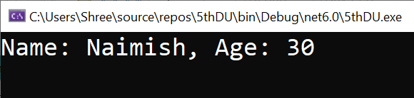
Example: Constructor
Example
Output
1
2
3
4
5
6
7
8
9
10
11
12
13
14
15
16
17
18
19
20
21
22
23
24
25
26
27
using System;
namespace MyFirstApp
{
class Program
{
public static void Main(string[] args)
{
Users user = new Users("Naimish", 30);
user.GetUserDetails();
Console.ReadLine();
}
}
public class Users
{
public string Name = string.Empty;
public int Age = 0;
public Users(string name, int age) //Parameterized Constructor
{
Name = name;
Age = age;
}
public void GetUserDetails()
{
Console.WriteLine("Name: {0}, Age: {1}", Name, Age);
}
}
}

Slide 64
Example: Copy Constructor
Example
1
2
3
4
5
6
7
8
9
10
11
12
13
14
15
16
17
18
19
20
21
22
23
24
25
using System;
namespace MyFirstApp
{
public class Users
{
public string Name = string.Empty;
public int Age = 0;
public Users(string name, int age) //Parameterized Constructor
{
Name = name;
Age = age;
}
public void GetUserDetails()
{
Console.WriteLine("Name: {0}, Age: {1}", Name, Age);
}
public Users(Users user) //Copy Constructor
{
this.Name = user.Name;
this.Age = user.Age;
}
}

Slide 65
Example: Copy Constructor
Example
Output
28
29
30
31
32
33
34
35
36
37
38
class Program
{
public static void Main(string[] args)
{
Users user1 = new Users("Naimish", 30);
Users user2 = new Users(user1);
user2.GetUserDetails();
Console.ReadLine();
}
}
}

Slide 66
Inheritance
Section - 10

Slide 67
Inheritance
In object-oriented programming, inheritance stands as a fundamental characteristic.
It provides the ability to create a child class that can reuse (inherit), extend, or alter the functionalities of a parent class.
The class whose members are inherited is called the base class.
The class that inherits the members of the base class is called the derived class.
Inheritance promotes code reuse, simplifies code maintenance, and improves code organizations.
It implements the IS-A relationship between a base class and one or more derived classes.

Slide 68
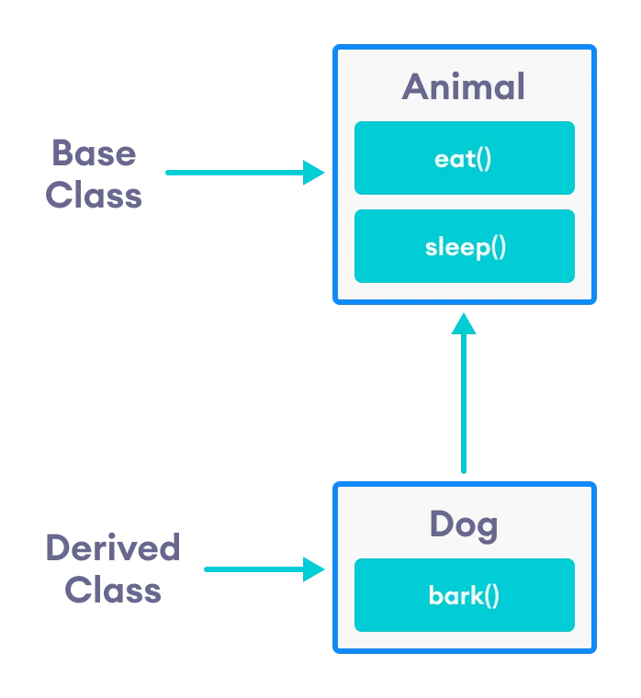
Inheritance cont..
Super Class: [Animal Class]
The class whose features are inherited is known as super class(or a base class or a parent class).
Sub Class: [Dog]
The class that inherits the other class is known as subclass(or a derived class, extended class, or child class).
The subclass can add its own fields and methods in addition to the superclass fields and methods.
Reusability:
Inheritance supports the concept of “reusability”, i.e. when we want to create a new class and there is already a class that includes some of the code that we want, we can derive our new class from the existing class.
By doing this, we are reusing the fields and methods of the existing class.

Slide 69
Inheritance Syntax
namespace Program
{
class parent
{
}
class child : parent
{
}
}
Class A (Base)
Class B (Derived)

Slide 70
Types of Inheritance
Single Inheritance
Multi-level Inheritance
Hierarchical Inheritance
Multiple Inheritance
Hybrid Inheritance

Slide 71
Single Inheritance
Single Inheritance
In single inheritance, a derived class is created from a single base class.
(There is only one parent class & one child class)
Class A (Base)
Class B (Derived)

Slide 72
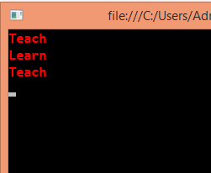
Example - Single Inheritance
//Base Class
class Teacher
{
public void Teach()
{
Console.WriteLine("Teach");
}
}
//Derived Class
class Student : Teacher
{
public void Learn()
{
Console.WriteLine("Learn");
}
}
class Program
{
static void Main(string[] args)
{
Teacher d = new Teacher();
d.Teach();
Student s = new Student();
s.Learn();
s.Teach();
Console.ReadKey();
}
}

Slide 73
Multi-level Inheritance
Multi-level Inheritance
In Multi-level inheritance, a derived class is created from another derived class.
Class A (Base)
Class B
Class C

Slide 74
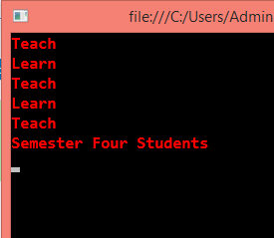
Example – Multi-Level Inheritance
//Base Class
class Teacher
{
public void Teach()
{
Console.WriteLine("Teach");
}
}
//Base,Derived Class
class Student : Teacher
{
public void Learn()
{
Console.WriteLine("Learn");
}
}
//Derived Class
class SemFour : Student
{
public void FourthSem()
{
Console.WriteLine("Semester Four Students");
}
}
class Program
{
static void Main(string[] args)
{
Teacher d = new Teacher();
d.Teach();
Student s = new Student();
s.Learn();
s.Teach();
SemFour Sem = new SemFour();
Sem.Learn();
Sem.Teach();
Sem.FourthSem();
Console.ReadKey();
}
}

Slide 75
Hierarchical Inheritance
Hierarchical Inheritace
There is one parent class that has more then one child class.
Class A
Class C
Class B
Class D
Class E
Class F
Class G

Slide 76
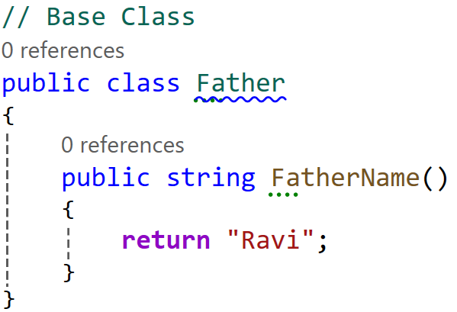
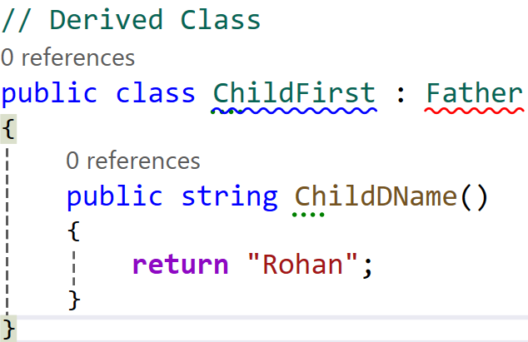
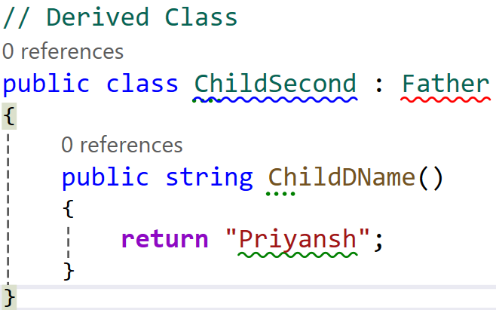
Example – Hierarchical Inheritance

Slide 77
Multiple Inheritance
Multiple Inheritance
In Multiple inheritance, child class can have more than one parent class.
This type of inheritance is not supported by .NET Languages like C#, F# etc.
Class A (Base)
Class B (Base)
Class C

Slide 78
Example – Multiple Inheritance
//Base Class
class Teacher
{
public void Teach()
{
Console.WriteLine("Teach");
}
}
//Base Class
class Student
{
public void Learn()
{
Console.WriteLine("Learn");
}
}
//Derived Class
class SemFour : Student , Teacher
{
public void FourthSem()
{
Console.WriteLine("Semester Four Students");
}
}

Slide 79
Hybrid Inheritance
Class A
Hybrid
Inheritance
It is mix of two or more of the above types of inheritance.
This type of inheritance is also not possible with classes in c#.
Class B
Class C
Class D

Slide 80
Advantages & Disadvantages of Inheritance
Advantages
Code Reusability : Inheritance allows us to reuse existing code by inheriting properties and methods from an existing class.
Code Maintenance : Inheritance makes code maintenance easier by allowing us to modify the base class and have the changes automatically reflected in the derived classes.
Code Organization : Inheritance improves code organization by grouping related classes together in a hierarchical structure.
Disadvantages
Tight Coupling : Inheritance creates a tight coupling between the base class and the derived class, which can make the code more difficult to maintain.
Complexity : Inheritance can increase the complexity of the code by introducing additional levels of abstraction.
Fragility : Inheritance can make the code more fragile by creating dependencies between the base class and the derived class.

Slide 81
Abstraction
Section - 11

Slide 82
Abstraction
Data abstraction is the process of hiding certain details and showing only essential information to the user.
Abstraction can be achieved with either abstract classes or interfaces.
The abstract keyword is used for classes and methods:
Abstract class: is a restricted class that cannot be used to create objects (to access it, it must be inherited from another class).
Abstract method: can only be used in an abstract class, and it does not have a body. The body is provided by the derived class (inherited from).
An abstract class can have both abstract and regular methods.

Slide 83
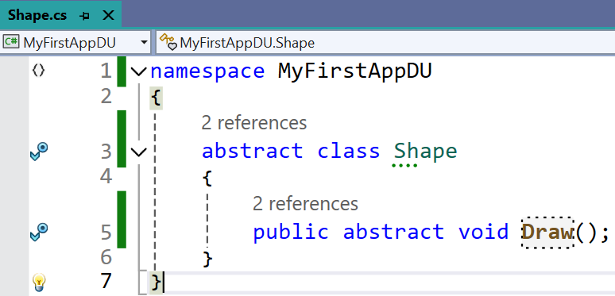
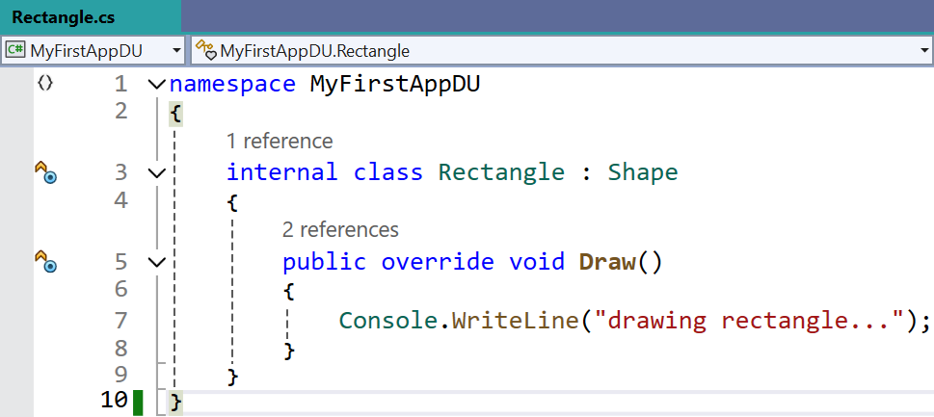
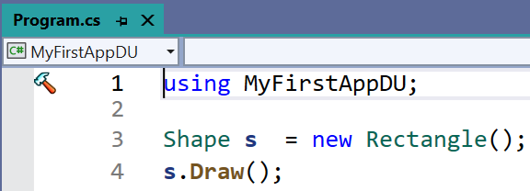
Example: Abstraction

Slide 84
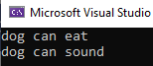
Example: Abstraction
Example
1
2
3
4
5
6
7
8
9
10
11
12
13
14
15
16
17
18
19
20
21
using System;
namespace First_Prg
{
abstract class animal
{
public abstract void eat();
public void sound()
{
Console.WriteLine("dog can sound");
}
}
class dog : animal
{
public override void eat()
{
Console.WriteLine("dog can eat");
}
}
24
25
26
27
28
29
30
31
32
33
34
35
class program
{
static void Main(string[] args)
{
dog mydog = new dog();
animal thePet = mydog;
thePet.eat();
mydog.sound();
}
}
}
Output

Slide 85
Interface
Section - 12

Slide 86

Interface: Introduction
Interface in C# is a blueprint of a class.
It is like abstract class because all the methods which are declared inside the interface are abstract methods.
It cannot have method body and cannot be instantiated (prior to C# 8.0).
An interface cannot contain constructors and fields.
Interface members are by default abstract and public, unless explicitly defined from C# 8.0 onward.
It is used to achieve multiple inheritance which can't be achieved by class.
It is used to achieve fully abstraction because it cannot have method body.
Its implementation must be provided by class.
The class which implements the interface, must provide the implementation of all the methods declared inside the interface unless default implementations are provided (in C# 8.0+).

Slide 87

Example: Interface
Example
Output
1
2
3
4
5
6
7
8
9
10
11
12
13
14
15
16
17
18
19
20
21
22
23
24
using System;
namespace First_Prg
{
interface Calculate
{
int add(int a, int b);
}
class Program: Calculate
{
public int add(int a, int b)
{
return a + b;
}
static void Main(string[] args)
{
Program program = new Program();
int sum = program.add(10, 20);
Console.WriteLine("Sum is: {0}",sum);
}
}
}

Slide 88
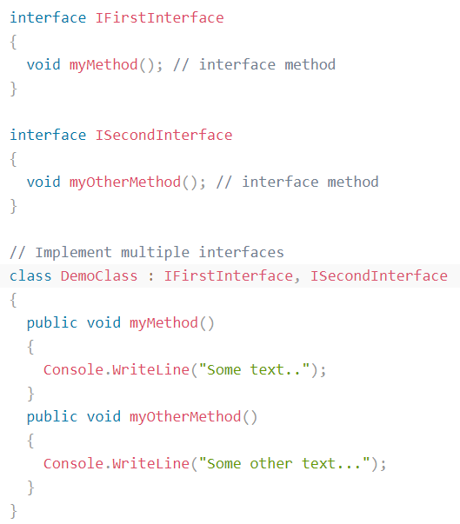

Example: Interface

Slide 89
Debugging and Error Handling
Section - 13

Slide 90
Debugging and Error Handling
Exception is a runtime error that arises because of some abnormal conditions, such as division of a number by zero and passing a string to a variable that holds an integer value.
Capturing and handling of runtime error is one of the important and crucial tasks for any programmer.
Compile time errors are those errors that occur during the compilation of a program.
It can happen due to bad coding or incorrect syntax.
We can correct these compile time errors after looking at the error message that the compiler generates.
On the other hand, runtime errors are those errors that occur during the execution of a program, and thus, they cannot be corrected at that time.
So, necessary actions need to be taken beforehand to prevent such types of errors.
To do so, you should first identify the following two aspects.
Find out those parts of a program which can cause runtime errors
How to handle those errors when they occur

Slide 91
Exception Handling
Exceptions can be handled by using the following two statements.
The try…catch…finally statement
The throw statement
try
The try block encloses the statements that might throw an exception.
catch
The catch block handles the exceptions thrown by the try block.
In a program, a try block can contain one or more catch blocks.
finally
It is an optional block and is always executed.
If no exception occurs inside the try block, the program control is transferred directly to the finally block.
try block
Code throws an exception?
Yes
catch block
No
finally block
All Errors Processed

Slide 92
Built-in Exception Classes
Class | Description
SystemException | Represents a base class for other exception classes
DivideByZeroException | Occurs if you try to divide a number by zero
IndexOutOfRangeException | Occurs if the index of an array is out of bound
FormatException | Occurs if there is an incorrect format of argument
OutOfMemoryException | Occurs if an execution stops due to lake of memory
StackOverflowException | Occurs if a stack overflows

Slide 93

Example: Exception Handling without try..catch
Output :
Unhandled exception.System.DivideByZeroException: Attempted to divide by zero in
line 3

Slide 94


Example: Exception Handling try..catch Cont..
Output :

Slide 95

Example: Exception Handling try..catch..finally Cont..
Output :
Exception caught: System.DivideByZeroException: Attempted to divide by zero. at Program.<Main>$(String[] args) in Program.cs:line 6
Result: 0

Slide 96


Example: Exception Handling try..catch..finally Cont..
Output :

Slide 97


Example: try with multiple catch blocks

Slide 98

The throw Statement
The throw statement allows us to create a custom error also.
It is used together with an exception classes.
Unhandled exception.System.DivideByZeroException: Attempted to divide by zero in line 3

Slide 99
Access Modifiers
Section - 14

Slide 100
Access Modifier
Access modifiers are keywords used to specify the declared accessibility of a member or a type.
Why to use access modifiers?
Access modifiers are an integral part of object-oriented programming.
They support the concept of encapsulation, which promotes the idea of hiding functionality.
Access modifiers allow you to define who does or doesn't have access to certain features.
In C# Modifiers can be divided in four categories.
Public
Private
Protected
Internal

Slide 101
Public Modifier
Public members are accessible anywhere in program or application.
Public access is the most permissive access level.
There are no restrictions on accessing public members.
The public keyword is used for it.
Accessibility:
Can be accessed by
Same class
Derived class (same or other project)
Same assembly (project)
Different assembly (referencing project)
Any external class or method
When to Use public?
When you want a class or member to be reusable across multiple projects or layers (e.g., public class, public API method).
For building libraries, shared components, or public APIs.

Slide 102

Example: Public Modifier
Example
Output
1
2
3
4
5
6
7
8
9
10
11
12
13
14
15
16
17
18
19
20
21
using System;
namespace Demo
{
class Access
{
public int num1;
}
class Program
{
static void Main(string[] args)
{
Access ob1 = new Access();
//Direct access to public members
ob1.num1 = 100;
Console.WriteLine("Number one value in main {0}", ob1.num1);
Console.ReadLine();
}
}
}

Slide 103
Private Modifier
Private members are accessible only within the body or scope of the class or the structure in which they are declared.
Private access is the least permissive access level.
The private keyword is used for it.
Accessibility:
Cannot be accessed by
Within the same class
Within a nested class
When to Use public?
To encapsulate data and hide implementation details from external access.
To follow OOP principles like abstraction and information hiding.
To restrict access to methods or data only needed inside the class itself.

Slide 104
Example: Private Modifier
Example
1
2
3
4
5
6
7
8
9
10
11
12
13
14
15
16
17
18
19
20
21
22
23
24
using System;
namespace Demo
{
class Access
{
public int num1;
private int num2;
}
class Program
{
static void Main(string[] args)
{
Access ob1 = new Access();
//Direct access to public members
ob1.num1 = 100;
//Access to private member is not permitted
ob1.num2 = 10;
Console.WriteLine("Number one value in main {0}", ob1.num1);
Console.ReadLine();
}
}
}
'Access.num2' is inaccessible due to its protection level.

Slide 105
Protected Modifier
A protected member is accessible from within the class in which it is declared and from within any class derived from the class that declared this member.
A protected member of a base class is accessible in a derived class only if the access takes place through the derived class type.
The protected keyword is used for it.
Accessibility:
Can be accessed by
Same class
Derived class (same project/assembly and different project/assembly)
When to Use public?
When you want to encapsulate data but share it with derived classes.
To hide implementation from outside the class hierarchy while supporting extension in subclasses.
Often used in base class templates, frameworks, or inheritance patterns.

Slide 106
Example: Protected Modifier
Example
1
2
3
4
5
6
7
8
9
10
11
12
13
14
15
16
17
18
19
20
21
22
23
24
25
26
using System;
namespace Demo
{
class Access
{
protected int num1;
}
class Program: Access
{
static void Main(string[] args)
{
Access access = new Access();
Program program = new Program();
//Access to protected member as it is inherited by derived class.
program.num1 = 20;
//Can not Access to protected member
access.num1 = 100;
Console.WriteLine("Number one value in main {0}", program.num1);
Console.ReadLine();
}
}
}

Slide 107
Internal Modifier
We can declare a class as internal or its member as internal.
Internal members are accessible only within the same assembly. [Assembly: An assembly is a compiled unit of code in .NET — like a .dll or .exe]
In other words, access is limited exclusively to classes defined within the current project assembly.
The internal keyword is used for it.
Accessibility:
The variable or classes that are declared with internal can be access by any member within application.
It is the default access specifiers for a class in C# programming.
When to Use public?
To hide implementation details from external consumers.
To expose functionality only for internal tools, unit tests, or debugging.
When building shared libraries, and you want to protect core components from misuse.

Slide 108

Example: Internal Modifier
Example
Output
1
2
3
4
5
6
7
8
9
10
11
12
13
14
15
16
17
18
19
20
21
22
23
24
25
26
using System;
namespace First_Prg
{
class access
{
// String Variable declared as internal
internal string name;
public void print()
{
Console.WriteLine("\nMy name is " + name);
}
}
class Program
{
static void Main(string[] args)
{
access ac = new access();
Console.Write("Enter your name: ");
// Accepting value in internal variable
ac.name = Console.ReadLine();
ac.print();
Console.ReadLine();
}
}
}

Slide 109
Default Access
A default access level is used if no access modifier is specified in a member declaration.
The following list defines the default access modifier for certain C# types:
C# Types | Description
Enum | The default and only access modifier supported is public.
Class | The default access for a class is internal. It may be explicitly defined using any of the access modifiers.
Nested Class | The default access for a class is private. It may be explicitly defined using any of the access modifiers.
Interface | The default and only access modifier supported is public.(Includes fields, methods, properties, constructors)
Class/struct members | The default access for a class/struct members is private. It may be explicitly defined using any of the access modifiers.
Interface and enumeration members are always public and no access modifiers are allowed.

Slide 110
Access Modifiers Comparison
Access Modifier | Same Class | Derived Class (Same Assembly) | Other Class (Same Assembly) | Derived Class (Other Assembly) | Other Class (Other Assembly) | Description
private | ✅ | ❌ | ❌ | ❌ | ❌ | Most restrictive; accessible only within the class.
protected | ✅ | ✅ | ❌ | ✅ | ❌ | Accessible within the class and derived classes.
internal | ✅ | ✅ | ✅ | ❌ | ❌ | Accessible within the same assembly only.
protected internal | ✅ | ✅ | ✅ | ✅ | ❌ | Accessible from same assembly and from derived classes in any assembly.
private protected | ✅ | ✅ | ❌ | ❌ | ❌ | Accessible within the same class and derived classes in the same assembly only.
public | ✅ | ✅ | ✅ | ✅ | ✅ | No restriction; accessible from anywhere.

Slide 111
Properties
Section - 15

Slide 112
Properties
In C#, properties are nothing but natural extension of data fields.
They are usually known as 'smart fields' in C# community.
We know that data encapsulation and hiding are the two fundamental characteristics of any object oriented programming language.
In C#, data encapsulation is possible through either classes or structures.
Properties are special kind of class member, In properties we use predefined Set and Get method.
Usually inside a class, we declare a data field as private and will provide a set of public SET and GET methods to access the data fields.
We can read, write or change the values of the private fields.
We cannot access these fields from outside the class, but we can accessing these private fields through properties.

Slide 113
Properties Cont..
A property is a combination of variable and a method.
A property is used to provide a flexible way to read, write, or change values of a private field.
The get method is used to return property value to the user.
The set method is used to assign a new value to the property.
Syntax
Public <return type> <PropertyName>
{
get
{
return <var>;
}
set
{
<var> = value;
}
}

Slide 114
Example - Properties
class Example
{
private int number;
public int Number
{
get
{
return number;
}
set
{
number = value;
}
}
}
class Program
{
static void Main(string[] args)
{
Example example = new Example();
// set { }
example.Number = 5;
// get { }
Console.WriteLine(example.Number);
}
}
Output :
5

Slide 115
Collection Classes
Section - 16

Slide 116
Collection Classes: Introduction
We mostly use arrays to store and manage data.
However, arrays can store a particular type of data, such as integer and characters.
To resolve this issue, the framework introduces the concept of collections for data storage and retrieval, where collection means a group of different types of data.
In arrays, you need to define the number of elements at declaration time (Dynamic Array).
But in a collection, you don't need to define the size of the collection in advance.
You can add elements or even remove elements from the collection at any point of time.

Slide 117
Collections Classes Types
The System.Collections namespace contains the non-generic collection types and System.Collections.Generic namespace includes generic collection types.
Generic Collections | Non-generic Collections
List<T> | ArrayList
Dictionary<TKey,TValue> | Bit Array
SortedList<TKey,TValue> | SortedList
Queue<T> | Queue
Stack<T> | Stack
Hashset<T> | Hashtable

Slide 118
Collection Classes (Non-generic)
The .NET Framework provides you a variety of collection classes, which are available in the System.Collections namespace.
Most useful collection classes defined are as follows.
ArrayList Class
Stack Class
Queue Class
Hashtable Class
BitArray Class

Slide 119
ArrayList Class
Similar to an array, the ArrayList class allows you to store and manage multiple elements.
Using an arrays, the main problem arises is that their size always remain fixed by the number that you specify when declaring an arrays.
In addition, you cannot add or remove items in the middle of array.
Also you can not deal with different data types.
The solution to these problems is the use of ArrayList Class, it allocated size dynamically and it gets double after elements value is filled.
With the ArrayList class, you can add and remove items from a list of array items from a specified position, and then the array items list automatically resizes itself accordingly.

Slide 120

Example – ArrayList Class
using System;
using System.Collections;
namespace MyFirstApp
{
class Program
{
static void Main(string[] args)
{
ArrayList A1 = new ArrayList();
A1.Add(10);
A1.Add("Hello");
A1.Add(true);
Console.WriteLine(A1[0]);
Console.WriteLine(A1[1]);
Console.WriteLine(A1[2]);
Console.ReadLine();
}
}
}
Output :

Slide 121

Example – ArrayList Class
using System;
using System.Collections;
namespace MyFirstApp
{
class Program
{
static void Main(string[] args)
{
ArrayList A1 = new ArrayList();
A1.Add(10); A1.Add("Hello"); A1.Add(true);
Console.WriteLine(A1.Count);
Console.WriteLine(A1.Contains(10));
Console.WriteLine("-------------------");
Console.WriteLine(A1[1]);
A1.RemoveAt(1);
Console.WriteLine(A1[1]);
Console.ReadLine();
}
}
}
Output :

Slide 122


Example – ArrayList Class

Slide 123
Stack Class
The stack class represents a last in first out (LIFO) concept.
let's take an example. Imagine a stack of books with each book kept on top of each other.
The concept of last in first out in the case of books means that only the top most book can be removed from the stack of books.
It is not possible to remove a book from between, because then that would disturb the setting of the stack.
Hence in C#, the stack also works in the same way.
Elements are added to the stack, one on the top of each other.
The process of adding an element to the stack is called a push operation.
The process of removing an element from the stack is called a pop operation.

Slide 124

Example – Stack Class (Push)
using System;
using System.Collections;
namespace MyFirstApp
{
class Program
{
public static void Main(string[] args)
{
Stack st = new Stack();
st.Push(1);
st.Push(2);
st.Push(3);
foreach (Object obj in st)
{
Console.WriteLine(obj);
}
Console.WriteLine("Total elements in the stack " + st.Count);
Console.WriteLine("Stack contain element 3? " + st.Contains(3));
Console.ReadLine();
}
}
}
Output :

Slide 125

Example – Stack Class (Pop)
using System;
using System.Collections;
namespace MyFirstApp
{
class Program
{
public static void Main(string[] args)
{
Stack st = new Stack();
st.Push(1);
st.Push(2);
st.Push(3);
st.Pop();
foreach (Object obj in st)
{
Console.WriteLine(obj);
}
Console.ReadLine();
}
}
}
Output :

Slide 126
Queue Class
The Queue class represents a first in first out (FIFO) concept.
let's take an example. Imagine a queue of people waiting for the bus.
Normally, the first person who enters the queue will be the first person to enter the bus.
Similarly, the last person to enter the queue will be the last person to enter into the bus.
The process of adding an element to the queue is the Enqueue operation.
The process of removing an element from the queue is the Dequeue operation.

Slide 127

Example – Queue Class (Enqueue)
using System;
using System.Collections;
namespace MyFirstApp
{
class Program
{
public static void Main(string[] args)
{
Queue qt = new Queue();
qt.Enqueue(1);
qt.Enqueue(2);
qt.Enqueue(3);
foreach (Object obj in qt)
{
Console.WriteLine(obj);
}
Console.WriteLine("Total elements in the queue =" + qt.Count);
Console.WriteLine("Queue contain element 3? " + qt.Contains(3));
Console.ReadLine();
}
}
}
Output :

Slide 128

Example – Queue Class (Dequeue)
using System;
using System.Collections;
namespace MyFirstApp
{
class Program
{
public static void Main(string[] args)
{
Queue qt = new Queue();
qt.Enqueue(1);
qt.Enqueue(2);
qt.Enqueue(3);
qt.Dequeue();
foreach (Object obj in qt)
{
Console.WriteLine(obj);
}
Console.ReadLine();
}
}
}
Output :

Slide 129
Hashtable Class
The Hashtable class is similar to the ArrayList class, but it allows you to access the items by a key.
Each item in a Hashtable object has a key/value pair.
So instead of storing just one value like the stack, array list and queue, the Hashtable stores 2 values that is key and value (hashcode).
The key is used to access the items in a collection and each key must be unique, whereas the value is stored in an array.
The keys are short strings or integers.
There is no direct way to display the elements of a Hashtable.
{ "1" , “Darshan" }
{ "2" , “Institute " }
{ "3" , "of Engg. & Technology" }
This is done via the ICollection interface. (This is a special data type which can be used to store the keys of a Hashtable collections)

Slide 130


Example – Hashtable Class

Slide 131

Example – Hashtable Class
using System;
using System.Collections;
namespace MyFirstApp
{
class Program
{
public static void Main(string[] args)
{
Hashtable ht = new Hashtable();
ht.Add("1", "Darshan");
ht.Add("2", "Institute");
ht.Add("3", "of Engg. & Technology");
ICollection keys = ht.Keys;
foreach (String k in keys)
{
Console.WriteLine(ht[k]);
}
Console.ReadLine();
}
}
}
Output :

Slide 132
BitArray Class
The BitArray class is used to manage an array of the binary representation using the value 1 and 0, where 1 stands for true and 0 stands for false.
A BitArray object is resizable, which is helpful in case if you do not know the number of bits in advance.
You can access items from the BitArray collection class by using an integer index.
A BitArray can be used to perform Logical AND, XOR, OR operations.

Slide 133

Example – BitArray Class
using System;
using System.Collections;
namespace MyFirstApp
{
class Program
{
public static void Main(string[] args)
{
BitArray ba = new BitArray(4);
ba[0] = true;
ba[1] = false;
ba[2] = true;
ba[3] = false;
foreach (Object obj in ba)
{
Console.WriteLine(obj);
}
Console.ReadLine();
}
}
}
Output :

Slide 134


Guess the Answer!!

Slide 135
Summary
Section - 17

Slide 136
Summary : Fundamentals of C# Programming
Overview & Namespace
C# is a modern, object-oriented language developed by Microsoft.
Namespace organizes code into groups; System is a common base namespace.
Variables & Data Types
Variables store data with specific types: int, float, string, bool, char, etc.
Implicit (var) and explicit type declarations.
Operators
Arithmetic: +, -, *, /, %
Comparison: ==, !=, >, <
Logical: &&, ||, !
Assignment: =, +=, -=, etc.
Strings
Immutable data type used to store text.
Immutable: a string whose content cannot be modified after it has been created
Common methods: .Length, .Substring(), .Replace(), .ToUpper()

Slide 137
Summary : Logic Flow & Data Handling
Conditions & Looping
Conditional Statements: if, else if, switch
Loops: for, while, do-while, foreach
Classes/Objects & Constructors
Class: Blueprint of object.
Object: Instance of class.
Constructor: Special method to initialize objects (default/parmeterized/copy).
Exception Handling
Prevent runtime crashes using try, catch, finally, and throw.
Collection Classes
Arrays: Fixed-size data structure.
List<T>, Dictionary<K,V>, Queue<T>, Stack<T> for dynamic data.

Slide 138
Summary : OOP Features
Access Modifiers
Control visibility: public, private, protected, internal
Properties
Encapsulate fields using { get; set; }
Can be auto-implemented or customized.
Inheritance
Enables class to reuse code from a base class using : operator.
Supports single inheritance.
Interface
Defines contract without implementation.
Implemented using interface keyword and : interfaceName in class.

Slide 139
Web Programming using .NET
#2305CS311
Prof. Madhuresh R Fichadiya
Computer Science & Engineering Department
madhuresh.fichadiya@darshan.ac.in
8866961282

